Slide 1

SDE Readiness Training
Empowering Tomorrow’s Innovators

Slide 2

Module II
Data Structures for Software Development Engineers using Java

Slide 3

Basics of Analysis of Algorithm
Learning Level: Basic
Date: 01.07.2024

Slide 4
AGENDA
Introduction to Analysis of Algorithm
Time Complexity
Space Complexity

Slide 5


Introduction to Analysis of Algorithm
Please download pictures in suitable size here and insert them by clicking the symbol above.

Slide 6
Analysis of Algorithm
Introduction to Analysis of Algorithm
An algorithm is a finite set of precise instructions for performing a computation or for solving a problem.
What is the goal of analysis of algorithms?
To compare algorithms mainly in terms of running time but also in terms of other factors (e.g., memory requirements, programmer's effort etc.)

Slide 7
Analysis of Algorithm
Introduction to Analysis of Algorithm
While analyzing an algorithm we should consider following factors :-
Time efficiency of an algorithm: It means the amount of time taken by an algorithm to run. By computing time complexity we come to know whether the algorithm is slow or fast.
Space efficiency of an algorithm: It means the amount of space (memory ) taken by an algorithm. By computing space complexity we can analyze whether an algorithm requires more or less space.

Slide 8
Types of Analysis
Introduction to Analysis of Algorithm
Worst case (Done usually)
maximum number of operations to be executed from an input of size n
Provides an upper bound on running time
Best case ( Not generally used)
minimum number of operations to be executed from an input of size n
Provides a lower bound on running time
Average case ( sometimes done)
average number of operations to be executed from an input of size n
Provides a tight bound on running time (Between upper bound and lower bound)

Slide 9
Types of Analysis
Introduction to Analysis of Algorithm
In general, the lower bound is the best case (least amount of work performed) and the upper bound is the worst case (most work the algorithm will have to do).

Slide 10
Types of Analysis
Introduction to Analysis of Algorithm
Upper Bound Theory:
According to the upper bound theory, for an upper bound U(n) of an algorithm, we can always solve the problem in at most U(n) time.
Time taken by a known algorithm to solve a problem with worse case input gives us the upper bound.
An upper bound is a guarantee that you will never exceed.
The worst case is the highest you can actually obtain.

Slide 11
Types of Analysis
Introduction to Analysis of Algorithm
Lower Bound Theory:
According to the lower bound theory, for a lower bound L(n) of an algorithm, it is not possible to have any other algorithm (for a common problem) whose time complexity is less than L(n) for random input.
Also every algorithm must take at least L(n) time in worst case. Note that L(n) here is the minimum of all the possible algorithm, of maximum complexity.

Slide 12
Asymptotic Analysis
Introduction to Analysis of Algorithm
In mathematical analysis, asymptotic analysis, also known as asymptotics, is a method of describing limiting behaviour.
To compare two algorithms with running times f(n) and g(n), we need a rough measure that characterizes how fast each function grows.
Asymptotic notation is a shorthand way to represent the time complexity and space complexity.
Using asymptotic notations we can give time complexity as “fastest possible”, “slowest possible” or “average time”.

Slide 13
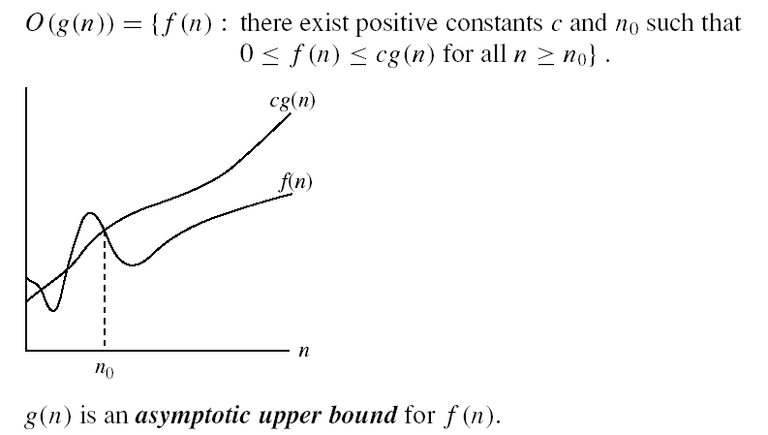
Asymptotic Notations
Introduction to Analysis of Algorithm
O-notation: The Big oh notation is a method of representing the upper bound of algorithm’s running time. Using big oh notation we can give longest amount of time taken by the algorithm to complete.
Definition: Let f(n) and g(n) be two non-negative functions.
n₀ is the break even point. It means from which the functions start to grows separately

Slide 14
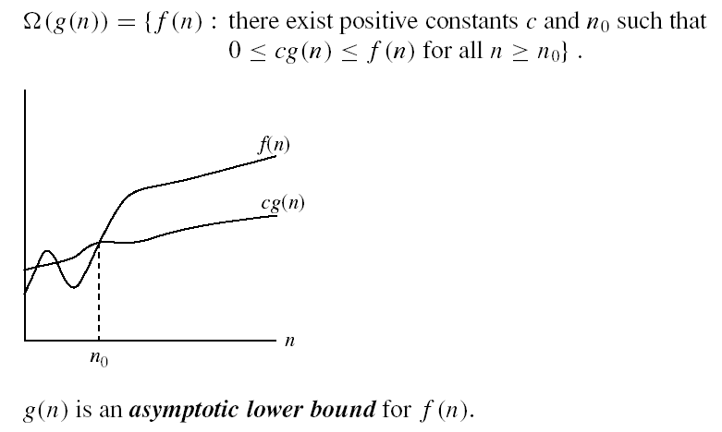
Asymptotic Notations
Introduction to Analysis of Algorithm
Ω - notation: The Omega notation is used to represent the lower bound of algorithm’s running time. Using Omega notation we can give shortest amount of time taken by the algorithm to complete.
Definition: Let f(n) and g(n) be two non-negative functions.
n₀ is the break even point. It means from which the functions start to grows separately

Slide 15

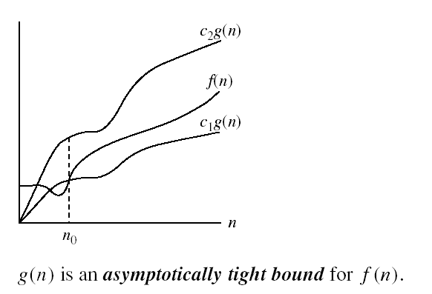
Asymptotic Notations
Introduction to Analysis of Algorithm
Θ-notation: Using theta notation we can give average amount of time taken by the algorithm to complete.
Definition: Let f(n) and g(n) be two non-negative functions.
n₀ is the break even point. It means from which the functions start to grows separately

Slide 16
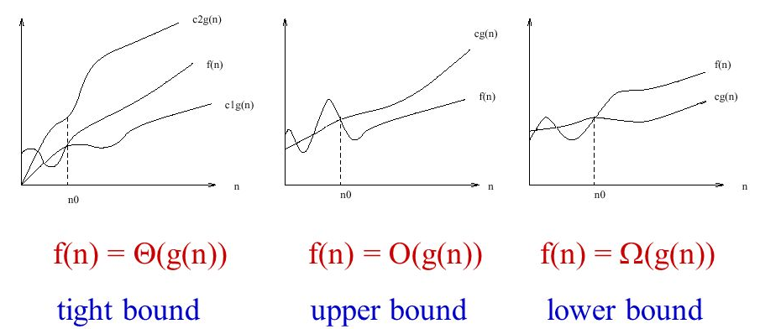
Asymptotic Notations
Introduction to Analysis of Algorithm
O notation: asymptotic “less than”:
f(n)=O(g(n)) implies: f(n) “≤” g(n)
Ω notation: asymptotic “greater than”:
f(n)= Ω (g(n)) implies: f(n) “≥” g(n)
Θ notation: asymptotic “equality”:
f(n)= Θ (g(n)) implies: f(n) “=” g(n)

Slide 17
Time Complexity
Please download pictures in suitable size here and insert them by clicking the symbol above.

Slide 18
Introduction
Time Complexity
The time complexity of an algorithm is the total amount of time required by an algorithm to complete its execution.
What do we mean by running time analysis?
Determine how running time increases as the size of the problem increases.
We need to define a number of objective measures.
(1) Compare execution times?
Not good: physically clocked times are specific to a particular computer !! (It depends on system load, number of other program running, instruction set used, speed of underlying hardware).
(2) Count the number of statements executed?
Not good: number of statements vary with the programming language as well as the style of the individual programmer.

Slide 19
Ideal Solution
Time Complexity
Express running time as a function of the input size n (i.e., f(n)).
Compare different functions corresponding to running times.
Such an analysis is independent of machine time, programming style, etc.

Slide 20
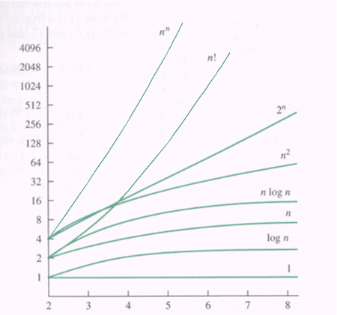
Order of Growth
Time Complexity
Measuring the performance of an algorithm in relation with the input size n is called order of growth.
Order of growth for varying input size of n
n | log n | nlogn | n² | 2^{n}
1 | 0 | 0 | 1 | 2
2 | 1 | 2 | 4 | 4
4 | 2 | 8 | 16 | 16
8 | 3 | 24 | 64 | 256
16 | 4 | 64 | 256 | 65536

Slide 21
General Methods
Time Complexity
It is difficult to compute the time complexity in terms of physically clocked time.
General Methods
Frequency Count : is a count denoting number of times of execution of statement.
Basic Operation: To identify the important operation (core logic ) of an algorithm. This operation is called the basic operation.
Generally the operation which is more time consuming is a basic operation in the algorithm. Normally such basic operation is located in inner loop.
Ex: Sorting algorithm the operation which is comparing the elements and then placing them at appropriate locations is a basic operation.

Slide 22
Frequency Count
Time Complexity
Example 1: sum of ‘n’ numbers
for(i=0;i<n;i++) {
sum=sum+a[i];
}
Frequency Count: 3n+2
Time Complexity is O(n) (Note: Ignore the constants value)
Statement | Frequency Count
i=0 | 1
i<n | (n+1)
i++ | n
sum=sum+a[i] | n
Total | 3n+2

Slide 23
Frequency Count
Time Complexity
Example 2: search elements in array
int count = 0;
for (int i = 0; i < arr.length; i++) {
if (arr[i] == target) {
count++;
}
}
Frequency Count: 3n+2
Time Complexity is O(n) (Note: Ignore the constants value)
Statement | Frequency Count
count = 0 | 1
i = 0 | 1
i < arr.length | n
i++ | n
if (arr[i] == target) | n
count++ | (variable)
Total | 3n+2

Slide 24
Frequency Count
Time Complexity
Example 3: addition of two matrix
for(i=0;i<n;i++) {
for(j=0;j<n;j++) {
c[i,j]=a[i,j]+b[i,j];
}
}
Frequency Count: 3n²+4n+2
Time Complexity is O(n²) (Note: Ignore the constants and smaller value)
Statement | Frequency Count
i=0 | 1
i<n | (n+1)
i++ | n
j=0 | 1*n=n
j<n | (n+1)*n=n²+n
j++ | n*n=n²
c[i,j]=a[i,j]+b[i,j] | n*n=n²
Total | 3n²+4n+2

Slide 25
Frequency Count
Time Complexity
Example 4: Count frequency of target value in 3D Array
int count = 0;
int N = arr.length;
for (int i = 0; i < N; i++) {
for (int j = 0; j < N; j++) {
for (int k = 0; k < N; k++) {
if (arr[i][j][k] == target) {
count++;
}
}
}
}

Slide 26
Frequency Count
Time Complexity
Example 4: Count frequency of target value in 3D Array
Frequency Count: 2n³ +4n²+5n+3
Time Complexity is O(n³) (Note: Ignore the constants value)
Statement | Frequency Count
count = 0 | 1
i = 0 | 1
i < N | n + 1
i++ | n
j = 0 | 1*n=n
j < N | (n+1)*n=n²+n
j++ | n*n=n²
Statement | Frequency Count
k = 0 | 1*n²= n²
k < N | (n²+n)*n= n³+n²
k++ | n*n*n = n³
arr[i][i][k]==target | n
count++ | variable
Total | 2n³ +4n²+5n+3

Slide 27
Basic Operation
Time Complexity
General Plan for Analysing Efficiency of Non-Recursive Algorithms
Decide the input size based on parameter n
Identify algorithm’s basic operation
Check how many times the basic operation is executed. Then find whether the execution of basic operation depends upon the input size n. If the basic operation depends upon worst case, average case and best case then that has to be analysed separately.
Set up a sum for the number of times the basic operation is executed.
Simplify the sum using standard formula and rules.

Slide 28
Basic Operation: Example
Time Complexity
Example: maximum element in a given array
Algorithm arrayMax(A,n)
Input: An array A storing n ≥ 1 integers.
Output: The maximum element in A.
currentMax ← A[0]
for i ← 1 to n - 1 do
if currentMax < A [i] then
currentMax ← A[i]
return currentMax

Slide 29
Basic Operation: Example
Time Complexity
Basic Operation: Comparison
As the comparison is made for each value of ‘n’ there is no need to find best case, worst case and average case analysis.
Let C(n) be the number of times the comparison is executed
C(n)=One comparison made for each value of ‘i’

Slide 30
Basic Operation: Example
Time Complexity
Example: maximum element in a given array
Let us simplify the sum
C(n)=∑
= n-1
= O(n) (Note: Ignore the constants)
n-1
∑
1
n
=1+1+….+1 = n
i=1
1
i=1

Slide 31
Solving Recurrence Equations
Time Complexity
Recurrence Relation
A recurrence relation is an equation that defines a sequence based on a rule that gives the next term as a function of the previous term(s).
The simplest form of a recurrence relation is the case where the next term depends only on the immediately previous term.

Slide 32
Solving Recurrence Equations
Time Complexity
The recurrence relation can be solved by following methods:
Substitution method, tree method and masters method
Substitution method
Forward Substitution
This method makes use of an initial condition in the initial term and value for the next term is generated.
This process is continue until some formula is guessed
But in practice, it is difficult to guess the pattern from forward substitution
Hence this method is not very often used.
Backward Substitution Method
Backward values are substituted recursively in order to derive some formula

Slide 33
Backward Substitution: Example
Time Complexity
1) T(n)=T(n-1)+n with Initial condition T(0)=0
T(n)=T(n-1)+n ------ (1)
T(n-1)=T(n-1-1)+n-1
=T(n-2)+n-1 -----(2)
Substitute (2) in (1)
T(n)=[ T(n-2)+n-1 ] +n
= T(n-2)+n-1+n -----(3)
T(n-2)=T(n-2-1)+n-2
=T(n-3)+n-2 ------(4)
Substitute (4) in (3)
T(n)= [T(n-3)+n-2]+n-1+n
=T(n-3)+n-2+n-1+n
T(n)=T(n-3)+(n-2)+(n-1)+n
In General,
T(n)=T(n-k)+(n-k+1)+(n-k+2)+n ---(5)
If k=n then (5) becomes
T(n)=T(n-n)+(n-n+1)+(n-n+2)+n
=T(0)+1+2+……+n
= n(n+1)/2
=n²/2+n/2
T(n)ϵO(n²) (Ignore smaller and constant values )

Slide 34
Forward Substitution: Example
Time Complexity
1) T(n)=T(n-1)+n with Initial condition T(0)=0
T(n)=T(n-1)+n
If n=1
T(1)=T(1-1)+1
=T(0)+1
=0+1=1
If n=2
T(2)=T(2-1)+2
=T(1)+2
=1+2=3
If n=3
T(3)=T(3-1)+3
=T(2)+3
=3+3=6
If n=4
T(4)=T(4-1)+4
=T(3)+4
=6+4=10
Based on above substitution, the general pattern is
1, 3, 6, 10,……
By observing above generated pattern we can derive a formula
T(n)=n(n+1)/2
=n²/2+n/2
T(n)ϵO(n²) (Ignore smaller constant values )

Slide 35
Solving Recurrence Algorithms
Time Complexity
General Plan for Analysing Efficiency of Recursive Algorithms
Decide the input size based on parameter n
Identify algorithm’s basic operation
Check how many times the basic operation is executed. Then find whether the execution of basic operation depends upon the input size n. If the basic operation depends upon worst case, average case and best case then that has to be analysed separately.
Set up the recurrence relation with some initial condition and expressing the basic operation.
Solve the recurrence or at least determine the order of growth. While solving the recurrence we will use the forward and backward substitution method. And then correctness of formula can be proved with the help of mathematical induction method.

Slide 36
Solving Recurrence Algorithms: Example
Time Complexity
To find the factorial of the given number
Basic Operation: Multiplication
Recurrence Relation
Let T(n) is the total amount of time taken to execute algorithm
T(n)=T(n-1) + 1
Algorithm factorial(n)
Input: Any positive real number.
Output: The factorial of the given number
if n==0 then
return 1;
else
return (n*factorial(n-1));
To multiply factorial(n-1) by n
These multiplications are required to compute factorial(n-1)

Slide 37
Solving Recurrence Algorithms: Example
Time Complexity
To find the factorial of the given number
T(n)=T(n-1)+1 n>0
=1 n=0 (Initial Condition)
Solve above recurrence relation using backward substitution method
T(n) =T(n-1)+1 ---(1)
T(n-1)=T(n-1-1)+1
=T(n-2)+1 ---(2)
Put (2) in (1)
T(n)=T(n-2)+2------(3)
T(n-2)=T(n-3)+2---(4)
Put (4) in (3)
T(n)=T(n-3)+3
In General
T(n)=T(n-k)+k
If k=n
T(n)=T(n-n)+n
=T(0)+n
=1+n
T(n)ϵO(n) (Ignore constant value)

Slide 38
Solving Recurrence Algorithms: Example
Time Complexity
Practice:
Algorithm 1
void test(int n)
{
if(n>0)
{
printf(“%d”,n);
test(n-1);
}
}
Recurrence Relation:
T(n)=T(n−1)+O(1)
Recurrence Relation
T(n)=T(n-1)+1 n>0
=1 n=0 (Initial Condition)

Slide 39
Solving Recurrence Algorithms: Example
Time Complexity
Practice:
Algorithm
void test(int n)
{
if(n>0)
{
for(i=0;i<n;i++)
{
printf(“%d”,n);
}
test(n-1);
}
Recurrence Relation
T(n)=T(n-1)+n n>0
=1 n=0 (Initial Condition)

Slide 40
Basic Efficiency Classes
Time Complexity
Name of efficiency class | Order of Growth | Description
Constant | O(1) | The constant amount of time. Example: # Odd or Even number # Look-up table (on average) # Accessing Elements in Arrays
Logarithmic | O(log n) | The algorithm does not consider all its input rather the problem is divided into smaller parts on each iteration. Example: # Finding element on sorted array with binary search # Finding the Nth Fibonacci Number
Linearithmic | O(n log n) | Some instance of input is considered for the list of size n. Example: # Sorting elements in array with merge sort, Quick sort, Heap sort.

Slide 41
Basic Efficiency Classes
Time Complexity
Name of efficiency class | Order of Growth | Description
Linear | O(n) | Depends on the input size is n. Example: # Find max element in unsorted array # Duplicate elements in array with Hash Map #Finding Maximum Subarray Sum using Kadane’s algorithm
Quadratic | O(n²) | The algorithm has two nested loops. Example: # Duplicate elements in array # Sort array with bubble sort, Selection sort, Insertion sort
Cubic | O(n³) | The algorithm has three nested loops. Example: # 3 variables equation solver # Matrix Multiplication.

Slide 42
Basic Efficiency Classes
Time Complexity
Name of efficiency class | Order of Growth | Description
Exponential | O(2^{n}) | When algorithm has very faster rate of growth. Example: # Find all subsets # Tower of Hanoi
Factorial | O(n!) | When algorithm is computing all permutations. Example: # Find all permutations of a given set/string # Traveling Salesman Problem (Brute force approach)

Slide 43
Space Complexity
Please download pictures in suitable size here and insert them by clicking the symbol above.

Slide 44
Introduction
Space Complexity
Total amount of computer memory required by an algorithm to complete its execution is called as space complexity of that algorithm.
Why do we care about space complexity?
We may not have sufficient memory space in our computer
When we solve a large‐scale problem, memory space is often a critical bottleneck.

Slide 45
Introduction
Space Complexity
Generally, when a program is under execution it uses the computer memory for THREE reasons.
Instruction Space: It is the amount of memory used to store compiled version of instructions.
Environmental Stack: It is the amount of memory used to store information of partially executed functions at the time of function call.
Data Space or Input Space: refers to the memory occupied by the input data itself. This includes all the.

Slide 46
Introduction
Space Complexity
data structures (like arrays, linked lists, trees, etc.) that store the input values the algorithm processes. The size of the data space is typically proportional to the size of the input.
Auxiliary space: refers to the extra space or temporary space used by the algorithm apart from the input data. This includes any additional variables, data structures, or recursion stack space that the algorithm needs for its execution.
Note
When we want to perform analysis of an algorithm based on its Space complexity, we consider only Data Space and Auxiliary space and ignore Instruction Space as well as Environmental Stack.

Slide 47
Example 1
Space Complexity
Data Space/Input Space:
The input is an array arr of size n, so the input space is O(n).
Auxiliary Space:
The algorithm uses a single variable total to store the sum. The space complexity for this variable is O(1) (constant space).No other significant additional data structures or recursion are used.
Total Space Complexity:
The total space complexity is the sum of the input space and auxiliary space, which is O(n) + O(1) = O(n).
Sums the elements of an array:
int sum_array(int arr[]) {
int total = 0
for (int num in arr)
total += num
return total
}

Slide 48
Example 2
Space Complexity
Data Space/Input Space:
The input is a 2D array arr of size m x n, where m is the number of rows and n is the number of columns. The input space for storing arr is O(m * n).
Auxiliary Space:
The algorithm uses a single variable sum to store the cumulative sum of the elements in the array. The space complexity for this variable is O(1) (constant space). No other significant additional data structures or recursion are used.
Total Space Complexity:
The total space complexity is the sum of the input space and auxiliary space, which is O(m * n) + O(1) = O(m * n).
Sums the elements in 2D array:
int findSum(int[][] arr) {
int sum = 0;
for (int i = 0; i < arr.length; i++) {
for (int j = 0; j < arr[i].length; j++) {
sum += arr[i][j];
}
}
return sum;
}

Slide 49
Example 3
Space Complexity
Data Space/Input Space:
The input is a 2D array arr of size m x n, where m is the number of rows and n is the number of columns. The input space for storing arr is O(m * n).
Auxiliary Space:
The algorithm uses a single variable sum to store the cumulative sum of the elements in the array. The space complexity for this variable is O(1) (constant space). No other significant additional data structures or recursion are used.
Total Space Complexity:
The total space complexity is the sum of the input space and auxiliary space, which is O(m * n) + O(1) = O(m * n).
Sums the elements in 2D array:
int findSum(int[][] arr) {
int sum = 0;
for (int i = 0; i < arr.length; i++) {
for (int j = 0; j < arr[i].length; j++) {
sum += arr[i][j];
}
}
return sum;
}

Slide 50
Example 4
Space Complexity
Data Space/Input Space:
The input is a 3D array arr of size x * y * z. The input space for storing array is O(x * y * z).
Auxiliary Space:
The loop variables are i, j, and k for iterating through the 3D array. These variables take up constant space. Therefore, the auxiliary space is O(1) (constant space).
Total Space Complexity:
The total space complexity is the sum of the input space and auxiliary space, which is O(x * y * z) + O(1) = O(x * y * z).
Create and Intialize 3D Array
int[][][] arr = new int[x][y][z];
for (int i = 0; i < x; i++) {
for (int j = 0; j < y; j++) {
for (int k = 0; k < z; k++) {
arr[i][j][k] = 0;
}
}
}
return arr;
}

Slide 51

Quiz
Analysis of Algorithm
1) The asymptotic notation for an algorithm that runs in constant time regardless of the input size
a) O(1)
b) O(log n)
c) O(n)
d) O(n^2)
Answer : a)

Slide 52
Quiz
Analysis of Algorithm
2) The asymptotic notation for an algorithm that runs in constant time regardless of the input size
a) Big O
b) Big Omega
c) Big Theta
d) Big Alpha
Answer : a)

Slide 53
Quiz
Analysis of Algorithm
3) Which of the following efficiency classes represents an algorithm that has a linear time complexity?
a) O(1)
b) O(log n)
c) O(n)
d) O(n^2)
Answer : c)

Slide 54
Quiz
Analysis of Algorithm
4) Which method of solving recurrence relations involves recursively substituting backward values to derive a formula?
a) Substitution method
b) Forward Substitution
c) Backward Substitution
d) Master's method
Answer : c)

Slide 55
Quiz
Analysis of Algorithm
5) Which of the following describes "Auxiliary Space" in the context of algorithm analysis?
a) The memory occupied by the input data structures, such as arrays and linked lists.
b) The extra space or temporary space used by the algorithm apart from the input data.
c) The total memory available in the system for executing an algorithm.
d) The amount of space required to store the output of the algorithm.
Answer : b)

Slide 56

Success is nothing more than a few straightforward disciplines put into daily practice.

